Slide 1
ITSAMI - Image Tagging Software Applicable to Many Images
Group 10
Taufeeq Ali, Connor Ford, Fernando Hernandez, Bowen Liu, Tanner Raley, Asher Schubert, San Yun, Joel Zuniga

Slide 2
Project Overview
ITSAMI (Image Tagging Software Applicable to Many Images) is a tool designed to use AI to tag and sort images provided by the user from their local directory.
The tool would take an image or image directory input, feed images to the AI model, the model would associate a given tag(s) with the image and then save the images to a local repository for the user to view later

Slide 3
Project Requirements
Functional Requirements
The software shall allow users to load images and their tags from directories into the application.
The software shall be able to display images and their tags.
The software shall be able to process images and create tags with the AI model.
The software shall be able to save an image’s tags as metadata for later use.
The software shall have a search function to find images by their tags.
The model should be able to be used through a Command Line Interface (CLI) in addition to within the application.
Non-Functional Requirements
The application shall be able to access and save multiple images contained in directories to the user’s system along with their associated tags.
The application shall return an image tagging request within several seconds to some minutes at most depending on image complexity and size
The application shall be able to support multiple tags per image.
The application should be portable.

Slide 4
Key Functionalities
The projects functionalities include
Taking image input from the user
Passing images to the AI model to be processed
Model views and parses images
Assigns tag to image based on key identifiers
Stores images in a local repository associated with the appropriate tag

Slide 5
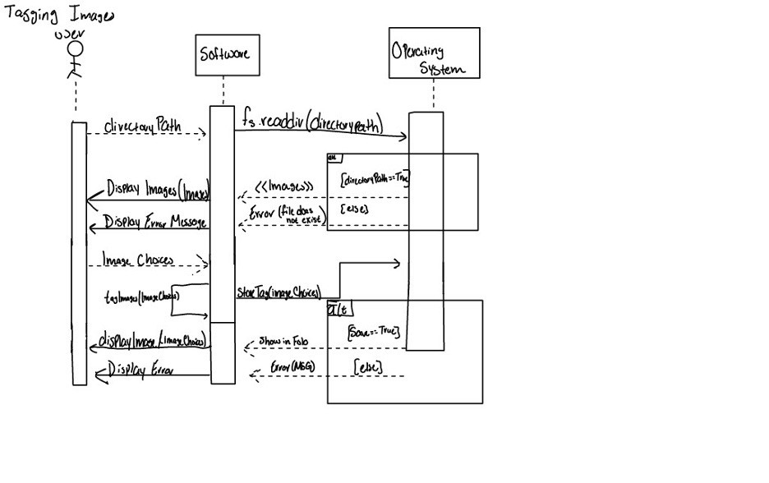
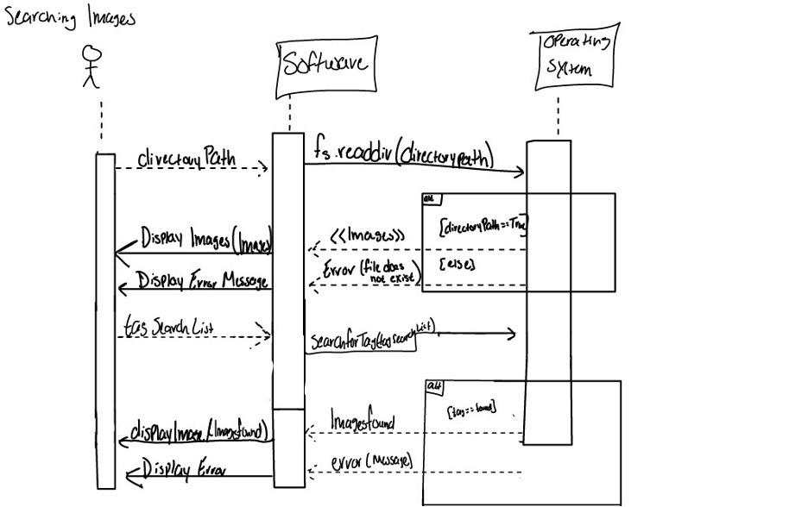
Diagrams 1 (sequence diagram)
Tagging Images
Searching Images

Slide 6
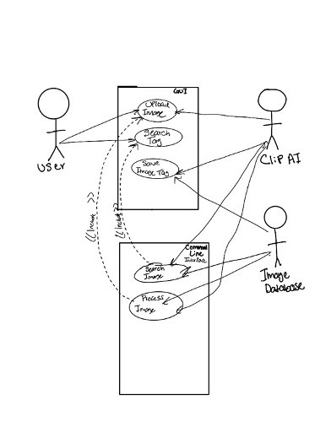
Diagrams 2 (Use-Case)

Slide 7
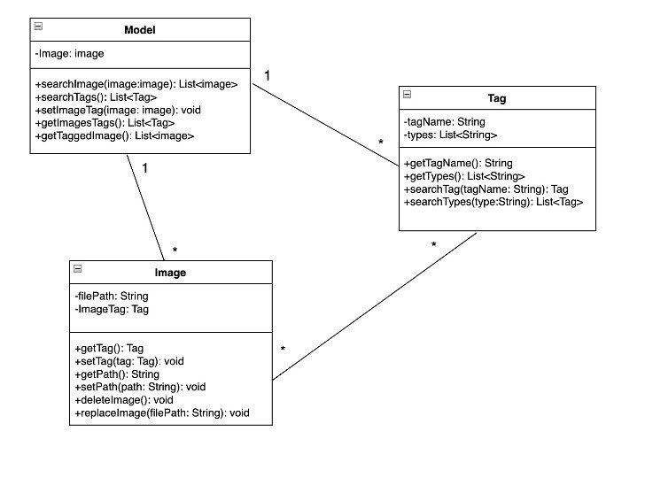
Diagrams 2 (Class)

Slide 8
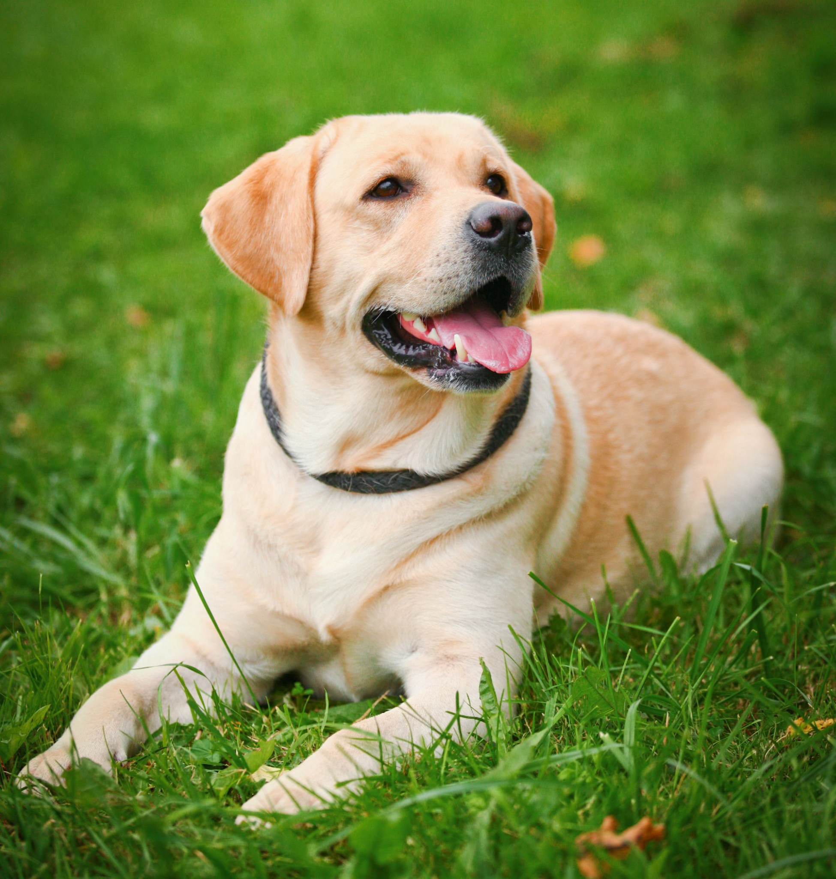
Testing
Black Box Testing
ITSAMI
Software
<Dog>
<Grass>

Slide 9
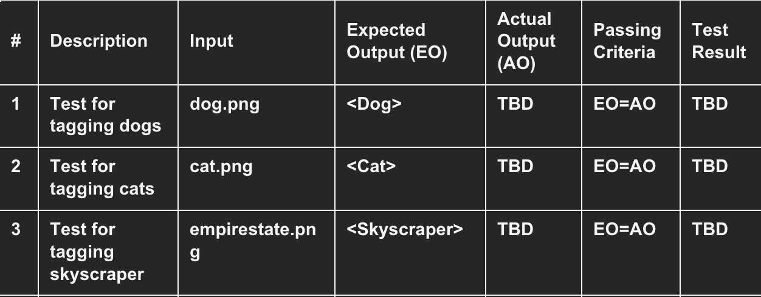
Testing
White Box Testing

Slide 10
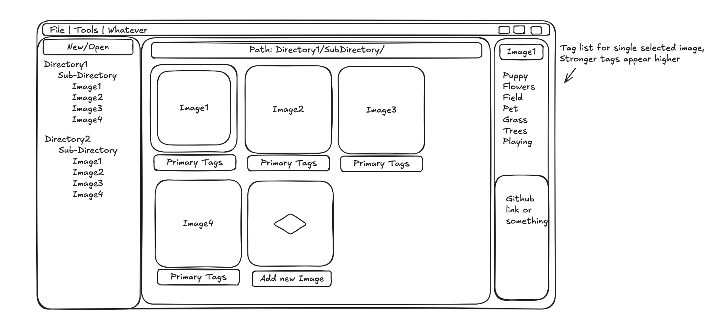
Prototype UI and Flow

Slide 11
Project Scheduling
Task | Effort (person-days) | Duration (days) | Dependencies | Activity
T1 | 10 | 4 | N/A | planning code structure
T2 | 20 | 10 | N/A | Culminate test image database
T3 | 45 | 15 | T1 | develop tagging software
T4 | 15 | 7 | T2 | Create possible image tag database
T5 | 15 | 5 | T3 | test individual tag creation
T6 | 5 | 3 | T3 | test new tag creation
T7 | 20 | 5 | T3 | test new image uploading and tagging

Slide 12
Project Scheduling Cont.
Days: | 1-3 | 4-6 | 7-9 | 10-12 | 13-15 | 16-18 | 19-21
Taufeeq
Connor
Fernando
Bowen
Tanner
Asher
San
Joel
T1 | T2 | T3 | T4 | T5 | T6 | T7

Slide 13
Feature | rclip | Eagle | Adobe Bridge | Hydrus | Our System Goal
GUI | ❌ | ✅ | ✅ | ✅ | ✅(Modern)
Auto-Tagging | ❌ | ❌ | ❌ | ❌ | ✅(AI-Powered)
Manual Tagging | ❌ | ✅ | ✅ | ✅ | ✅
Offline Support | ✅ | ✅ | ✅ | ✅ | ✅
Advanced Search | ❌ | ✅(Basic) | ✅(Metadata) | ✅ | ✅(AI + Filters)
Performance | ✅ | ✅(Medium) | ❌(Heavy) | ❌(Slow) | ✅
Cross-Platform | ✅ | ✅ | ❌(Win/Mac) | ✅ | ✅
Metadata Support | ❌ | ✅ | ✅ | ✅ | ✅
Batch Processing | ❌ | ✅ | ✅ | ✅ | ✅
Extensibility | ❌ | ✅(Plugins) | ✅(Scripts) | ✅(Plugins) | ✅(Plugins)

Slide 14
Conclusion
TODO Convert conclusion paragraphs into concise bullet points for presentation - Connor
For Deliverable 2, our team concentrated on applying core software engineering principles to carefully plan out the ITSAMI project. We developed and refined key project artifacts, including requirements specifications, process models, architectural designs, scheduling plans, cost estimates, and detailed testing strategies. This exercise gave us the opportunity to systematically walk through every major phase of the software development lifecycle, following a structured and disciplined approach.
Throughout the process, we ran into several challenges that are typical when tackling early-stage project planning. Crafting clear, realistic functional and non-functional requirements took multiple revisions to ensure everything aligned with our bigger project goals. Estimating cost and effort without a working implementation meant we had to make careful assumptions and extrapolations. Maintaining consistency between design artifacts, such as diagrams and architectural models, demanded ongoing communication and frequent changes. Lastly, creating a prototype of what the ITSAMI project would look like presented conflicting information with previous design artifacts that had to be remedied.
One of the biggest takeaways from this deliverable was how critical early, thorough planning is for reducing risks and setbacks down the road. Working within a team environment also reinforced the need for clear role delegation and strong documentation habits. That said, coordinating across such a large group wasn’t easy; scheduling meetings was a challenge and forced us to figure out more flexible forms of communication to stay in sync.
In summary, Deliverable 2 demonstrates a solid grasp of the software engineering process and sets a strong foundation for the potential future development of the ITSAMI application.
Notes:
TODO Convert conclusion paragraphs into concise bullet points for presentation - Connor

Slide 15
References
Mikhalevich, Yurij. “Using Text Queries to Look up Unlabeled Images: A Command-Line Search Tool Based on Clip.” ThinkMind(TM) Digital Library, 26 June 2023, www.thinkmind.org/index.php?view=article&articleid=content_2023_1_20_60011.

Slide 16
Similar Design Comparisons
Adobe Bridge
Purpose: File browser with metadata management for creatives.
Strengths:
Metadata Filtering: EXIF, IPTC, custom keywords.
Integration: Works with Photoshop/Lightroom.
Weaknesses:
No AI: Tagging is manual.
Bloated: Heavy resource usage.
Hydrus Network
Purpose: Advanced local media tagging.
Strengths:
Powerful Tagging: Boolean search, wildcards, namespaces.
Customization: Plugins for external AI.
Weaknesses:
Steep Learning Curve: Overwhelming for casual users.
No Native AI: Requires manual setup.

Slide 17
Similar Design Comparisons
rclip(Existing CLI Tool)
Purpose: Searches local images using OpenAI CLIP embeddings via text queries.
Strengths:
Fast, scriptable, and lightweight
Works offline after setup
Weaknesses:
No GUI: Requires command-line knowledge.
Outdated Model: Uses older CLIP(ViT-B/32), missing newer improvements.
No Auto-Tagging: Only search, no persistent tagging system.
Eagle App
Purpose: Asset manager for designers
Strengths:
Visual Browsing: Grid/column views, quick previews.
Manual Tagging: Support folders, labels, and annotations.
Extensions: Some AI plugins(but not deeply integrated)
Weaknesses:
No Built-in AI Tagging: Relies on manual input.
Proprietary: Not open-source.

Slide 18
Task Delegations
Deliverable 1
Taufeeq Ali: Class Diagram
Connor Ford: Outlining Software Process Model, Functional Requirements, GitHub repository
Fernando Hernandez: Use-Case Diagram
Bowen Liu: Updated Version of Proposal
Tanner Raley: Non-Functional Requirements, Architectural Design
Asher Schubert: Activity/Sequence Diagram
San Yun: Class Diagram
Joel Zuniga: Functional Requirements, Non-Functional Requirements
Deliverable 2
Taufeeq Ali: Slides and Presentation
Connor Ford: Project management, GitHub repository, conclusion
Fernando Hernandez: Software Testing
Bowen Liu:
Tanner Raley: Project Scheduling, Cost, Effort and Pricing Estimation, Project Duration and Staffing, Estimated Costs of Hardware, Software, and Personnel
Asher Schubert: Refinement of Requirements, UI Mockup
San Yun: Slides and Presentation
Joel Zuniga: UI

